Slide 1
Economics HS20001
Source : The Economy

Slide 2
Introduction

Slide 3
Some news headlines –
GDP likely to contract by 7.7% in 2020-21, says Govt
https://www.thehindu.com/business/Economy/indias-real-gdp-estimated-to-contract-by-77-in-2020-21/article33521311.ece
India’s GDP to contract 7.7% in current fiscal, advance estimates show
https://indianexpress.com/article/business/economy/gdp-to-contract-7-7-in-current-fiscal-advance-estimates-show-7137643/
India’s GDP set to drop 7.7%, biggest contraction since 1952 http://timesofindia.indiatimes.com/articleshow/80155191.cms?utm_source=contentofinterest&utm_medium=text&utm_campaign=cppst
https://www.mospi.gov.in/documents/213904/416359//Presss%20note_FAE-2020-211610021181596.pdf/9fff7a5d-29da-9a4b-971f-cfb7b0f05500

Slide 4
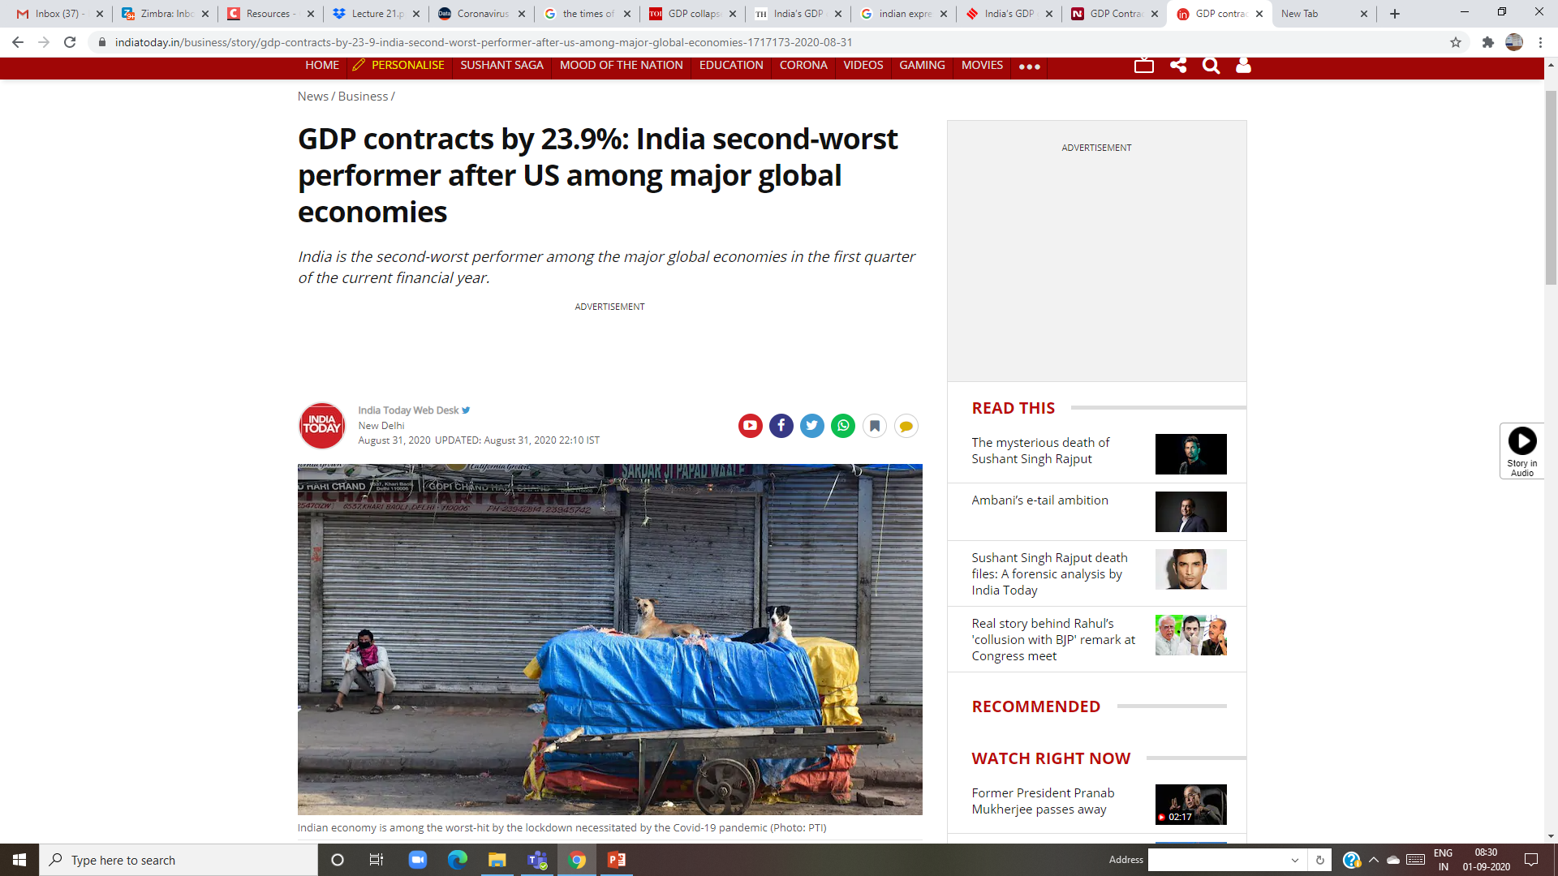
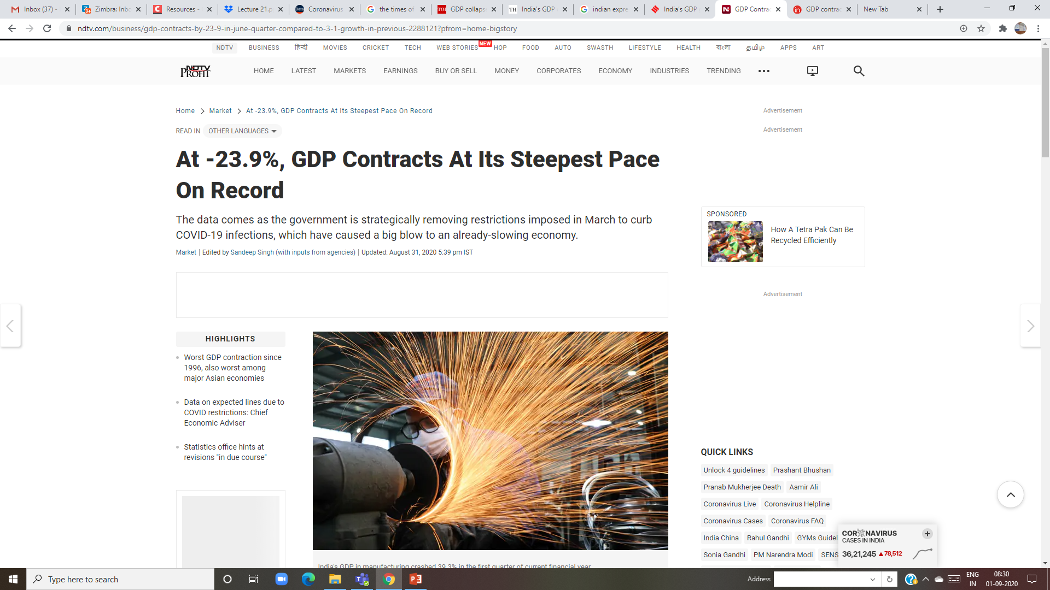
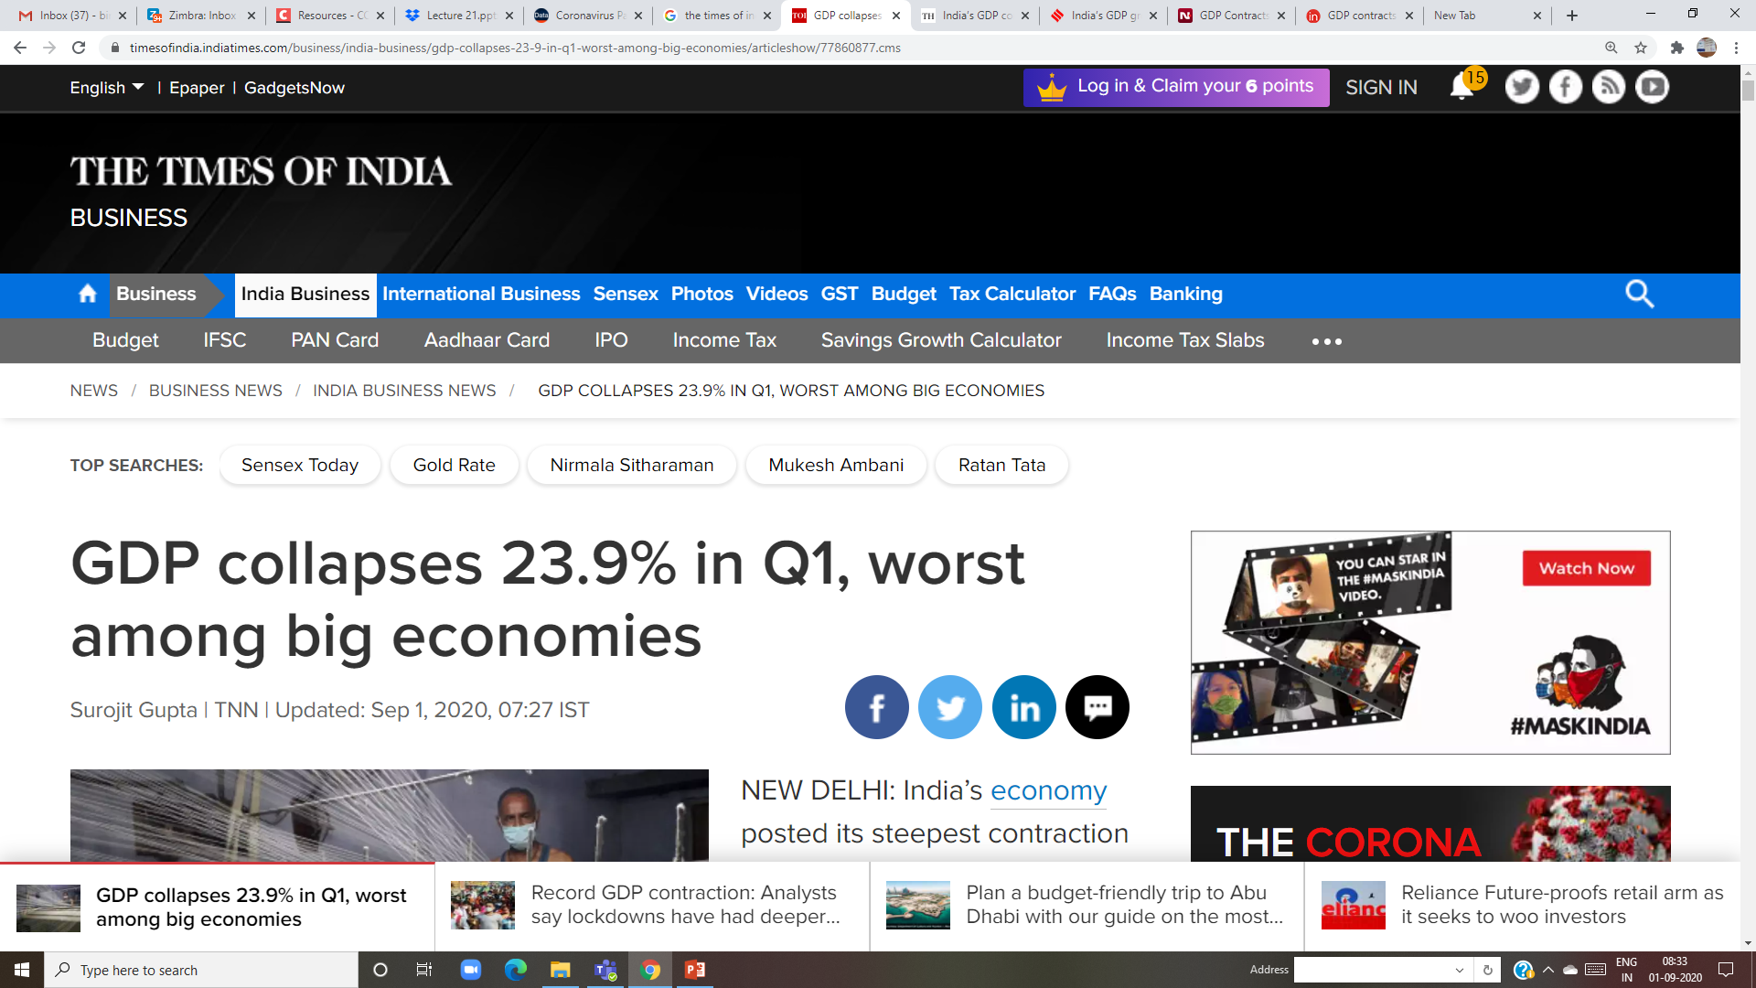
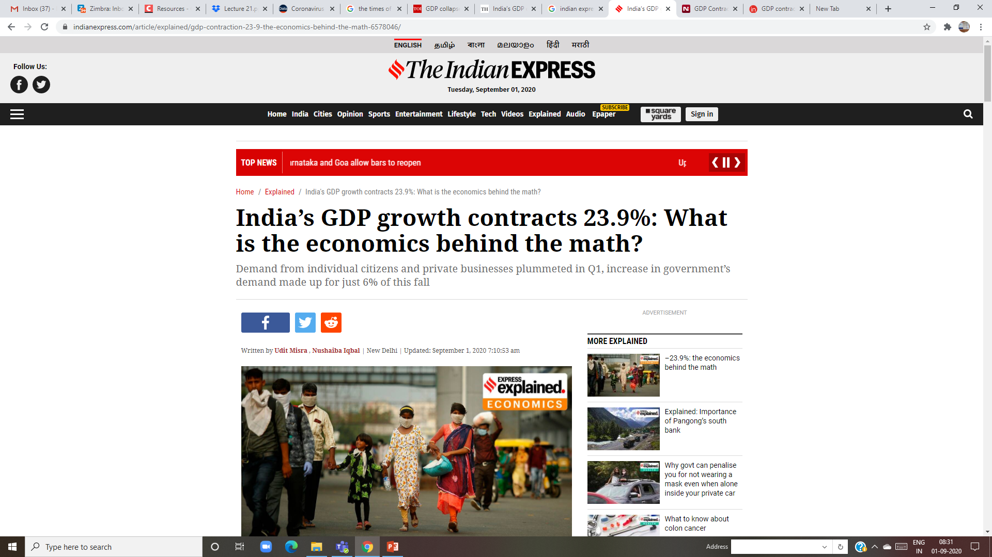
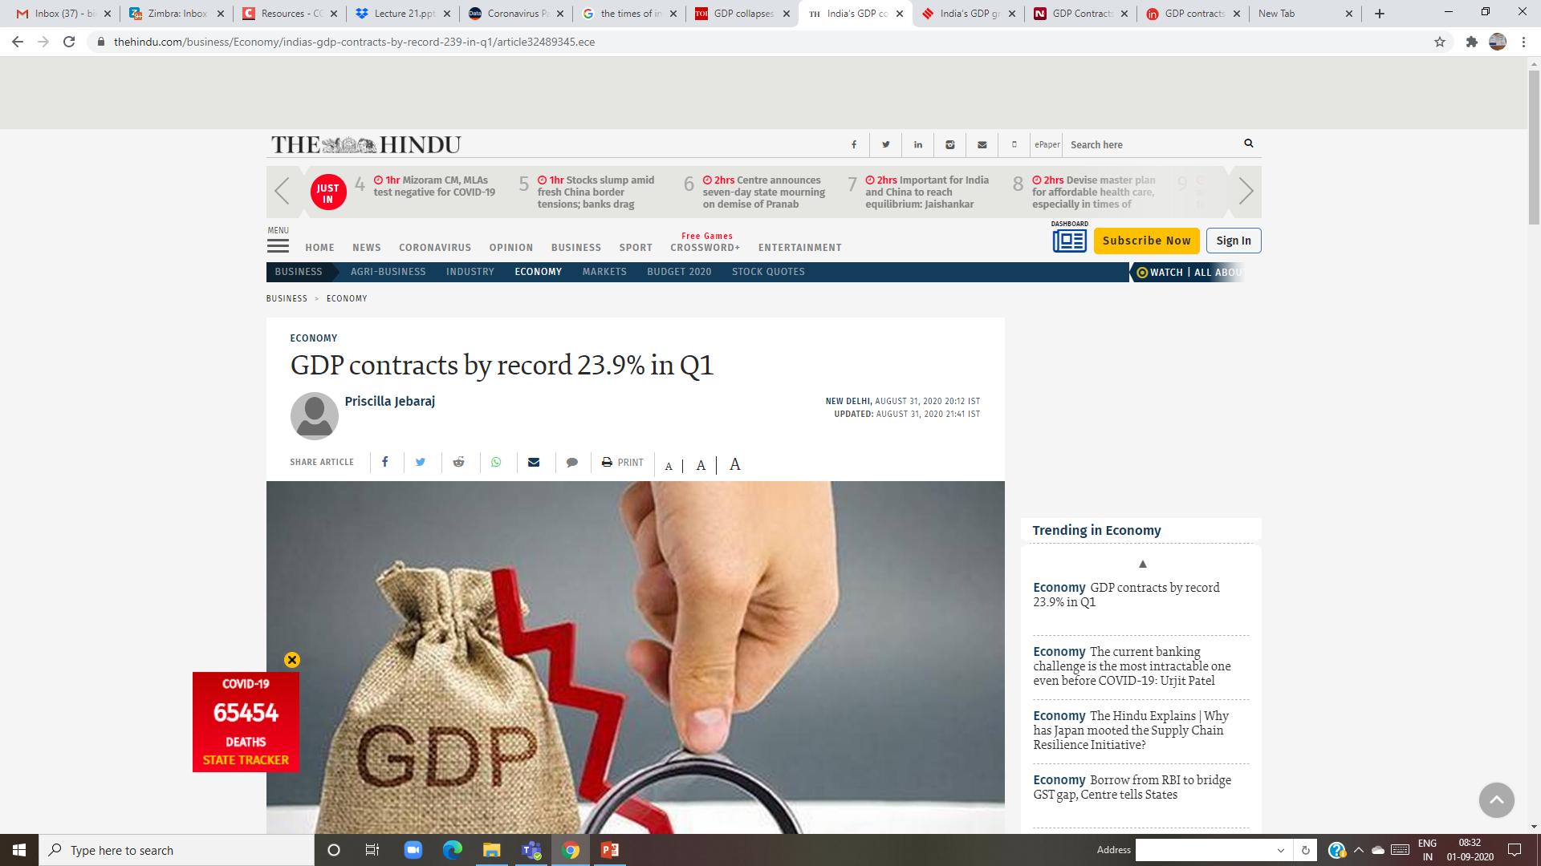
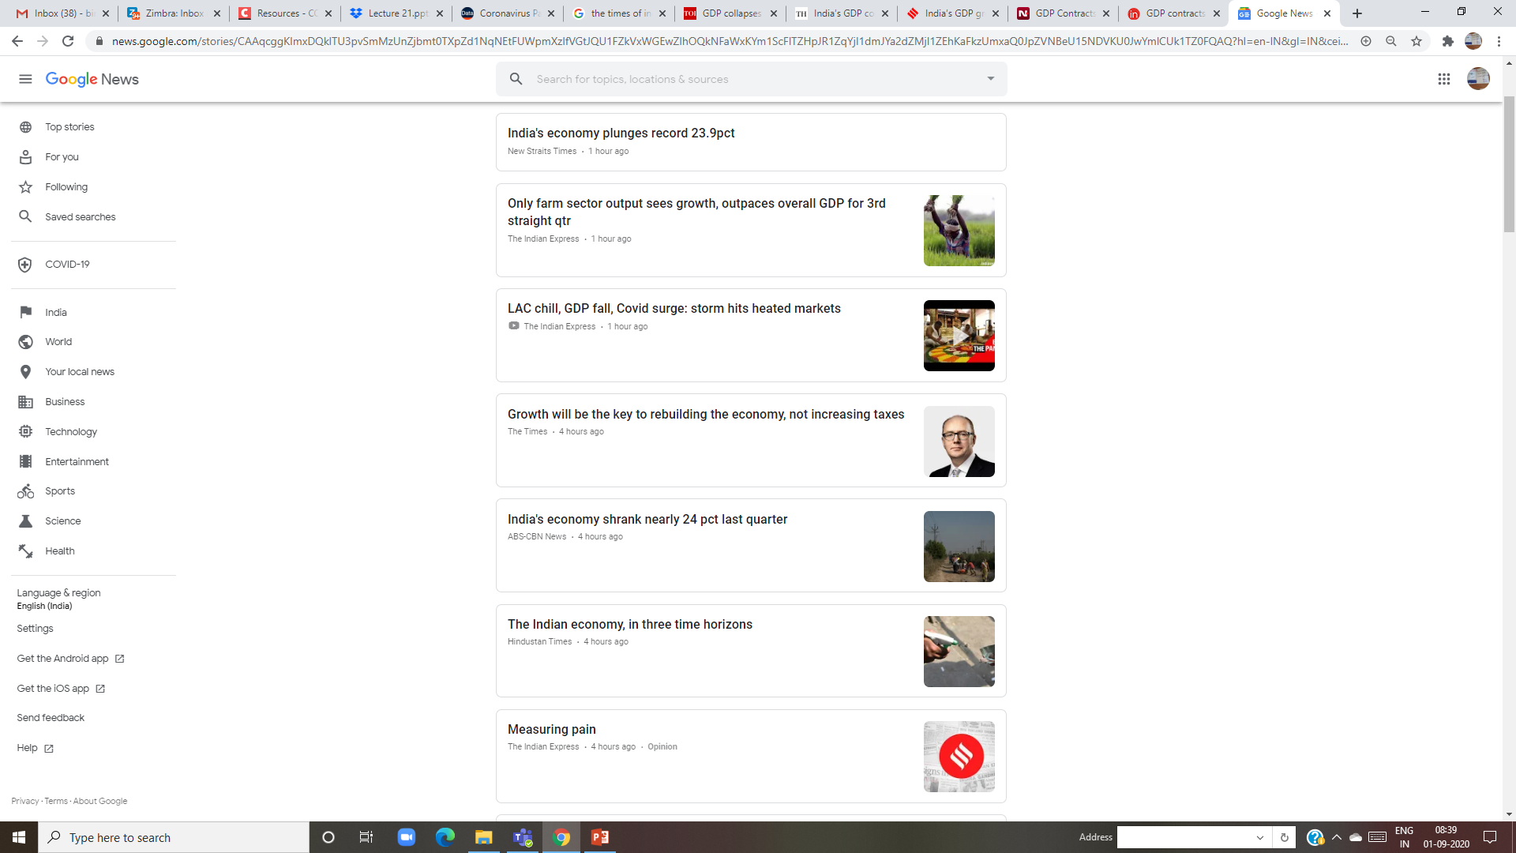

Slide 7
https://www.mospi.gov.in/documents/213904/416359//PRESS_NOTE-Q2_2020-211606480008567.pdf/f2b98a11-a06d-8b6f-6f37-621f33ca8f25

Slide 9
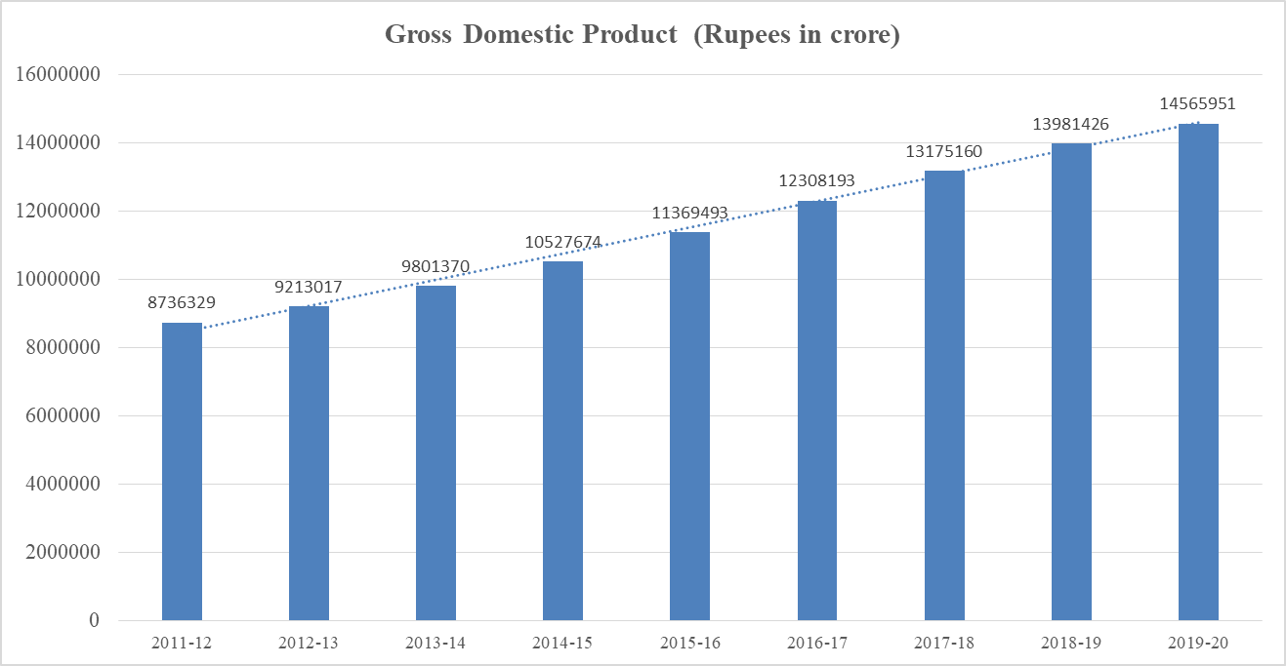

Slide 10
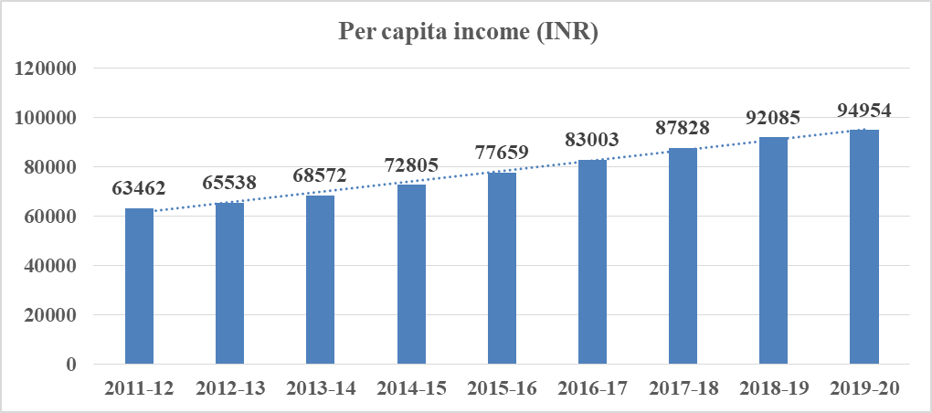

Slide 12
http://www.mospi.gov.in/sites/default/files/press_release/PRESS%20NOTE%20PE%20and%20Q4%20estimates%20of%20GDP.pdf
https://www.rbi.org.in/Scripts/AnnualPublications.aspx?head=Handbook%20of%20Statistics%20on%20Indian%20Economy
https://databank.worldbank.org/source/world-development-indicators

Slide 13
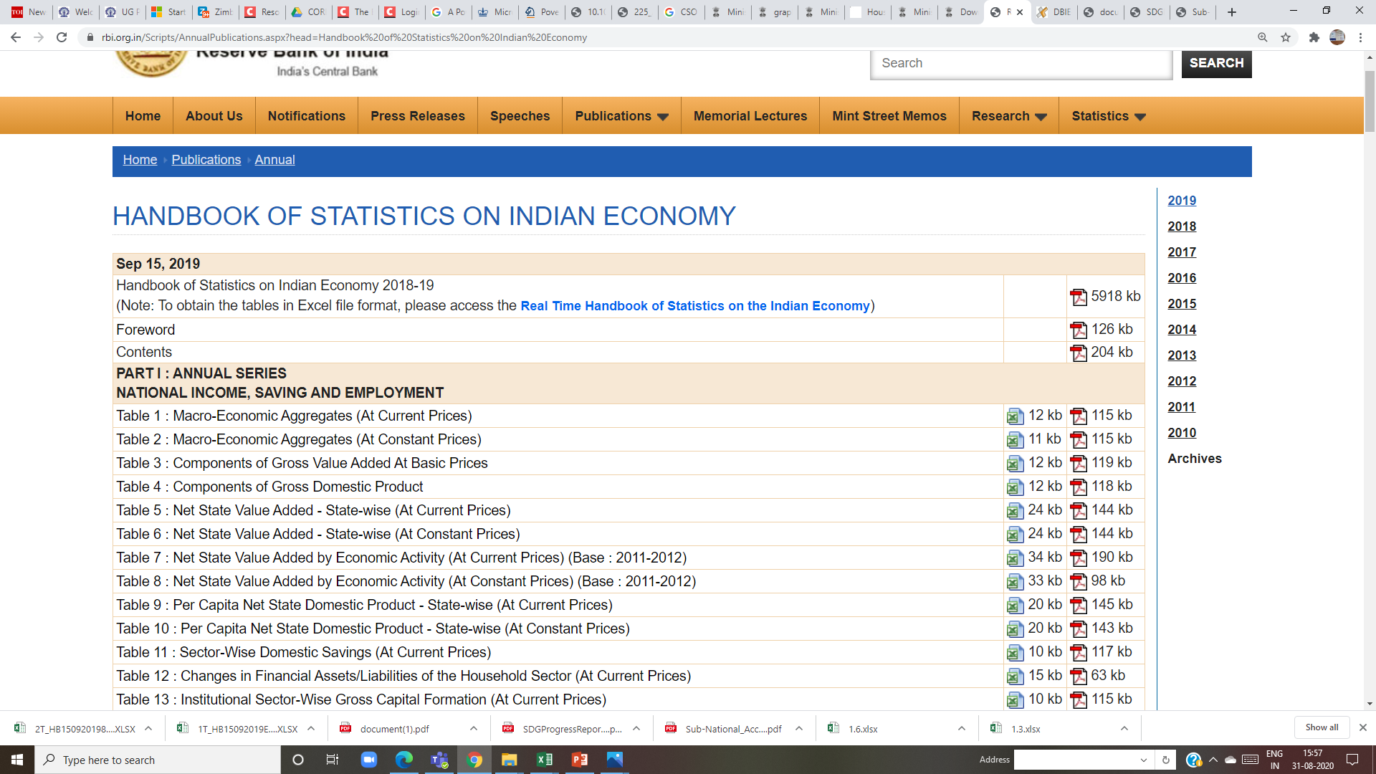
https://www.rbi.org.in/Scripts/AnnualPublications.aspx?head=Handbook%20of%20Statistics%20on%20Indian%20Economy

Slide 14
Rapid, sustained growth in average living standards since 1700.
How did this happen?

Slide 15
Inequality

Slide 16
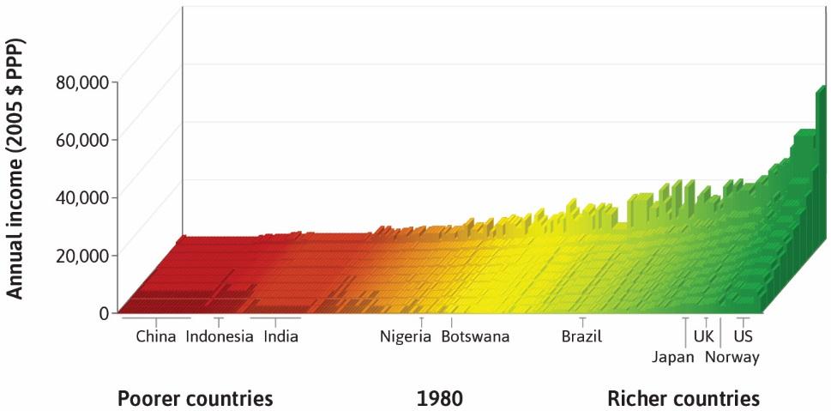
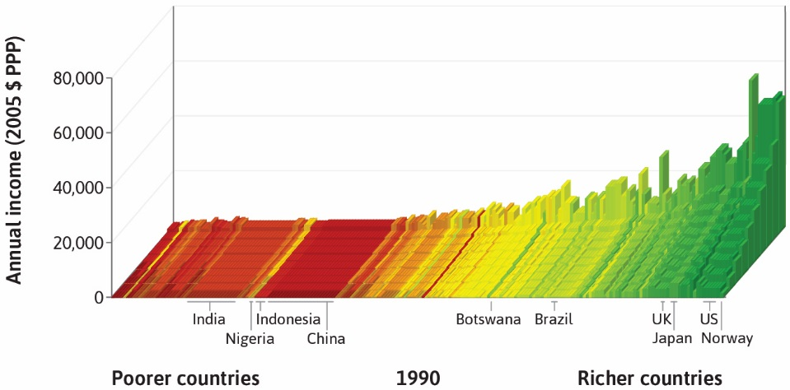
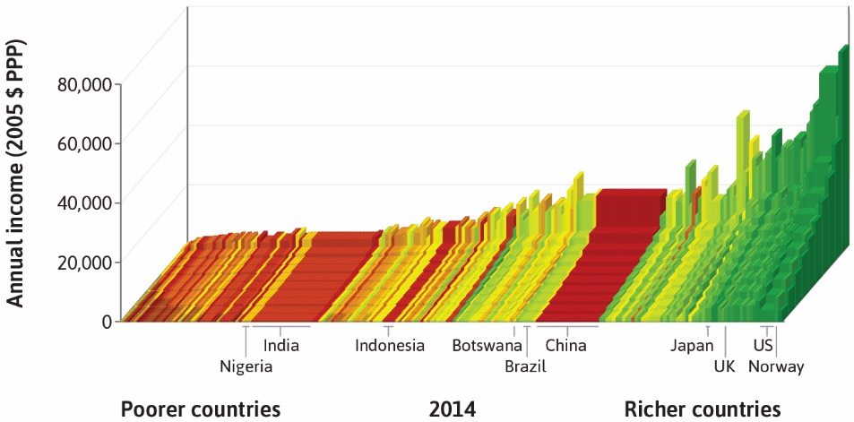
How unequal is the world?
1980
1990
2014
In Singapore, the richest country on the furthest right, the average incomes of the richest and poorest 10% are $67,436 and $3,652 respectively.
In Liberia, the furthest left, the corresponding incomes are $994 and $17.

Slide 18
Measuring income and living standards
Gross Domestic Product (GDP) = A measure of total income and output of the economy in a given period.
Usually expressed in per-capita terms (as an average income).
GDP per capita ≠ Disposable income
Disposable income = Total income – taxes + government transfers
Both are imperfect measures of well-being

Slide 19
“Hockey-stick” growth

Slide 20
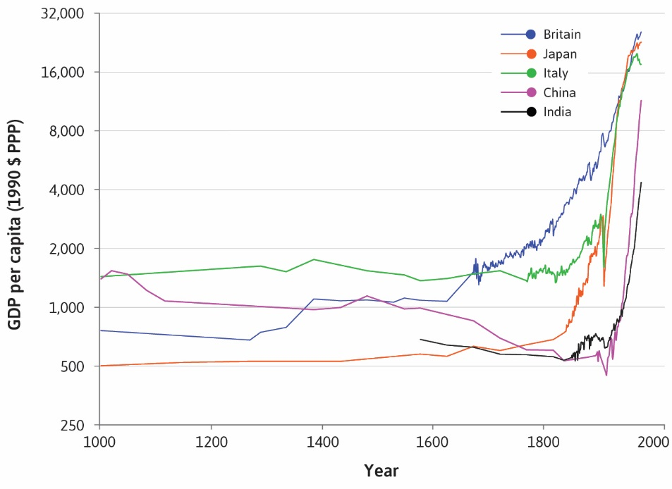
GDP growth rates
“Hockey-stick” curves represent the sustained rapid growth in GDP per capita experienced by countries worldwide.

Slide 21
The Technological Revolution
Technology = A process that uses inputs to produce an output.
By reducing the amount of work-time it takes to produce the things we need, technological changes allowed significant increases in living standards.
Remarkable scientific and technological advances occurred more or less at the same time as the upward kink in the hockey stick in Britain in the middle of the 18th century.

Slide 22
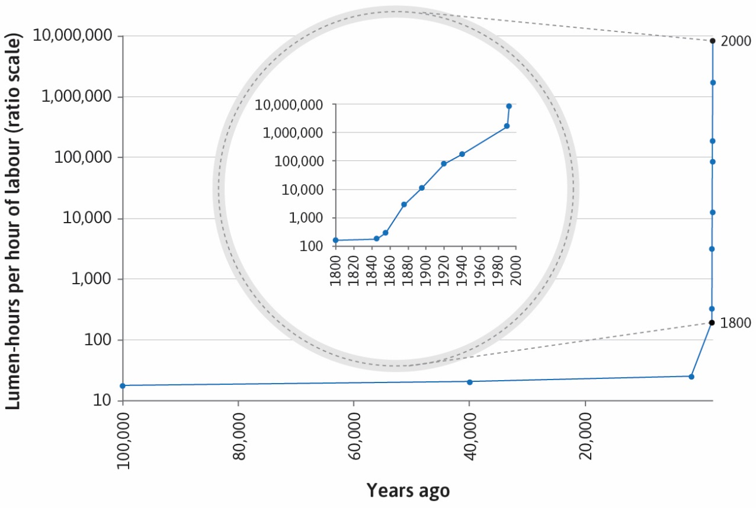
The Industrial Revolution
Industrial Revolution = a wave of technological advances starting in Britain in the 18th century, which transformed an agrarian and craft-based economy into a commercial and industrial economy.
For example, today the productivity of labour in producing light is half a million times greater than it was among our ancestors around their campfire.

Slide 23
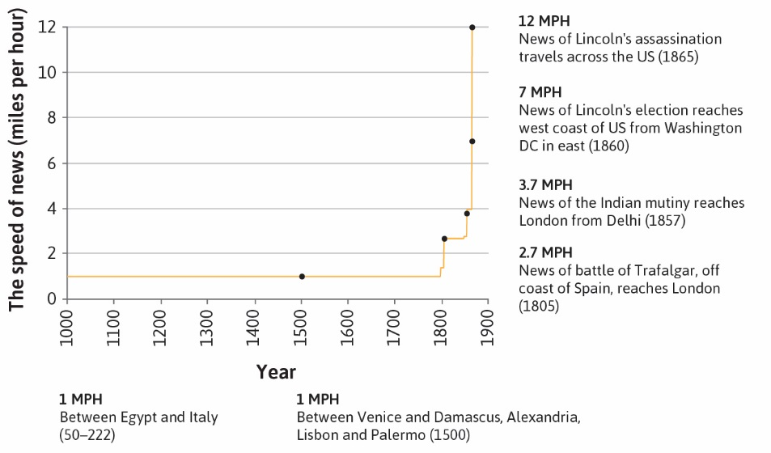
A Connected World
Technological progress also greatly improved the speed at which information travels, making the world more connected.

Slide 24
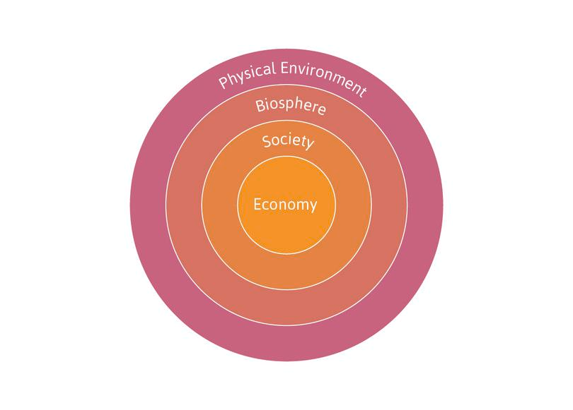
Figure 1.5 The economy is part of society, which is part of the biosphere.

Slide 25
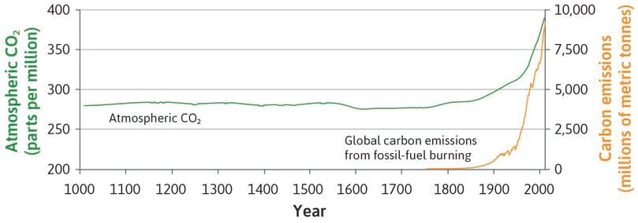

Slide 26
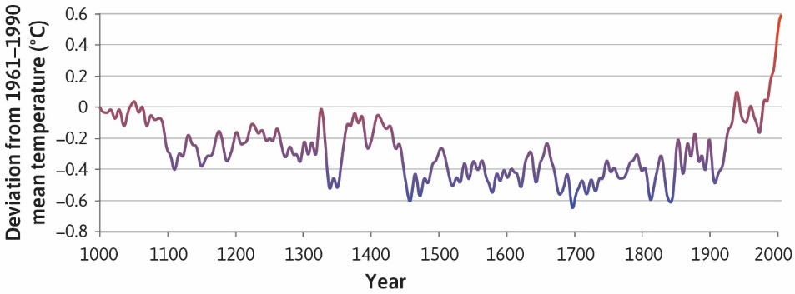
Environmental consequences
Increased production and population growth affects the environment
Global impacts – climate change
Local impacts – pollution in cities, deforestation
Technology may provide the solution

Slide 27
Environmental consequences
These effects are results of both
the expansion of the economy (illustrated by the growth in total output)
the way the economy is organized (what kinds of things are valued and conserved, for example).
The permanent technological revolution may also be part of the solution, by making it possible to use less resources to produce more output.

Slide 28
Capitalism

Slide 29
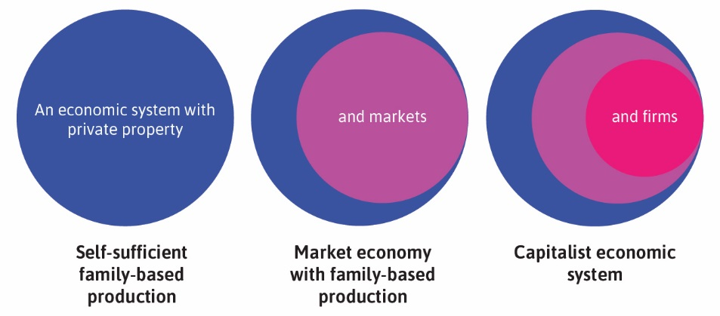
Capitalism
Institutions are the laws and social customs governing the production and distribution of goods and services.
Capitalism = an economic system where the main institutions are private property, markets, and firms.

Slide 30
The Capitalist Revolution
Capitalism led to growth in living standards because of:
impact on technology: firms competing in markets had strong incentives to adopt and develop new technologies
specialization: the growth of firms and the expansion of markets linking the entire world allowed historically unprecedented specialization in tasks and production
Together with the technological revolution, this increased worker productivity.

Slide 31
The gains from specialization
Specialization increases productivity of labour because we become better at producing things when we each focus on a limited range of activities
learning by doing
taking advantage of natural differences in skill and talent
economies of scale
People can only specialize if they have a way to acquire the other goods they need. In a capitalist society, this is done via markets.

Slide 32
Adam Smith begins The Wealth of Nations with the following sentence:
The greatest improvement in the productive powers of labour, and the greater part of the skill, dexterity, and judgement with which it is anywhere directed, or applied, seem to have been the effects of the division of labour.
Division of Labour is Limited by the Extent of the Market’, in which Smith explains:
When the market is very small, no person can have any encouragement to dedicate himself entirely to one employment, for want of the power to exchange all that surplus part of the produce of his own labour, which is over and above his own consumption, for such parts of the produce of other men’s labour as he has occasion for.

Slide 33
Comparative advantage
 | Production if 100% of time is spent on one good
Greta | 1250 apples or 50 tonnes of wheat
Carlos | 1000 apples or 20 tonnes of wheat
Greta has absolute advantage in production of both crops
Greta has a comparative advantage in wheat
Carlos has a comparative advantage in apples = he is least disadvantaged in production of apples.

Slide 34
 |  | Self-sufficiency | Complete specialization and trade
 |  |  | Production |  | Trade |  | Consumption
 |  | 1 | 2 |  | 3 |  | 4
Greta | Apples | 500 | 0 |  |  |  | 600
 | Wheat | 30 | 50 | = | 15 | + | 35
Carlos | Apples | 300 | 1,000 | = | 600 | + | 400
 | Wheat | 14 | 0 |  |  |  | 15
Total | Apples | 800 | 1,000 |  | 600 |  | 1,000
 | Wheat | 44 | 50 |  | 15 |  | 50

Slide 35
Comparative advantage
All producers can benefit by specializing and trading goods, even when this means that one producer specializes in a good that another could produce at lower cost.
Markets contribute to increasing the productivity of labour by allowing people to specialize.

Slide 36
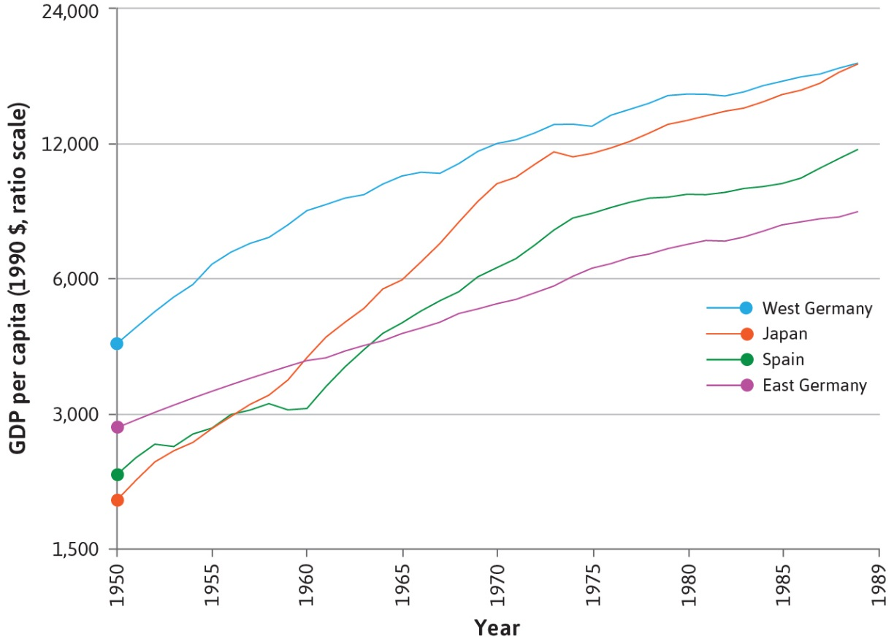
Did capitalism cause the hockey-stick growth?
Natural experiment: the division of Germany at the end of World War II into two separate economic systems, capitalist in the west and centrally planned in the east.

Slide 37
Divergence in growth
Not all capitalist economies are equally successful
economic conditions: firms, private property, or markets may fail
political conditions: capitalist institutions are regulated by the government
the government also provides essential goods and services (infrastructure, education)

Slide 38
Political systems
Capitalism coexists with many political systems.
A political system determines how governments will be selected, and how those governments will make and implement decisions.
In most countries today, capitalism coexists with democracy
individual rights of citizens (e.g. freedom of speech)
fair elections
But capitalism has coexisted with non-democratic systems, too.

Slide 39
Economics

Slide 40
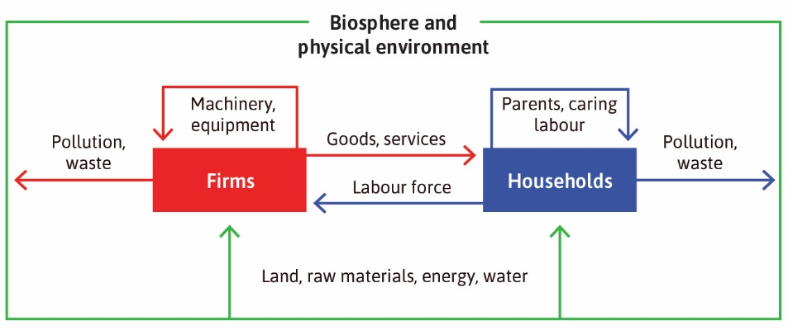
What is Economics?
Economics is the study of how people interact with each other and with their natural surroundings in producing their livelihoods, and how this changes over time.

Slide 41
Summary
Important trends in economic variables over time
Income inequality across regions has increased a lot over time
“Hockey-stick” growth in GDP, and its negative consequences
Technological progress helped bring about these trends
2. The adoption of capitalism was another key factor
Capitalism = Private property + Markets + Firms
Failure of these institutions can explain divergence in economic growth across countries
Political systems and the role of government also determine the type of capitalist society

